Slide 1
Qualitative data analysis

Slide 2
Qualitative data analysis
in social sciences

Slide 3
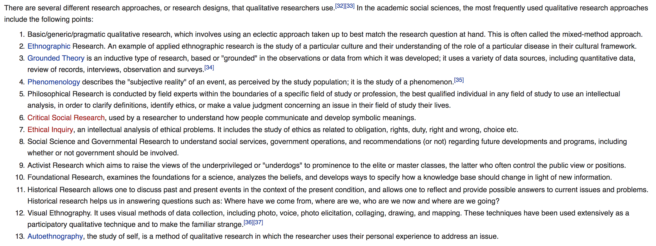
“The method”

Slide 4
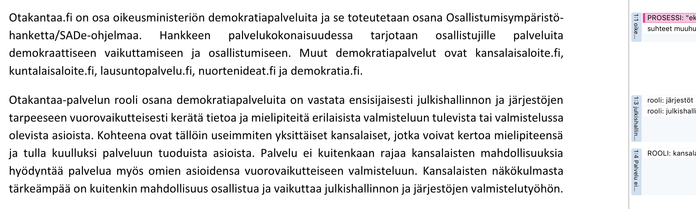
Coding in qualitative research

Slide 5
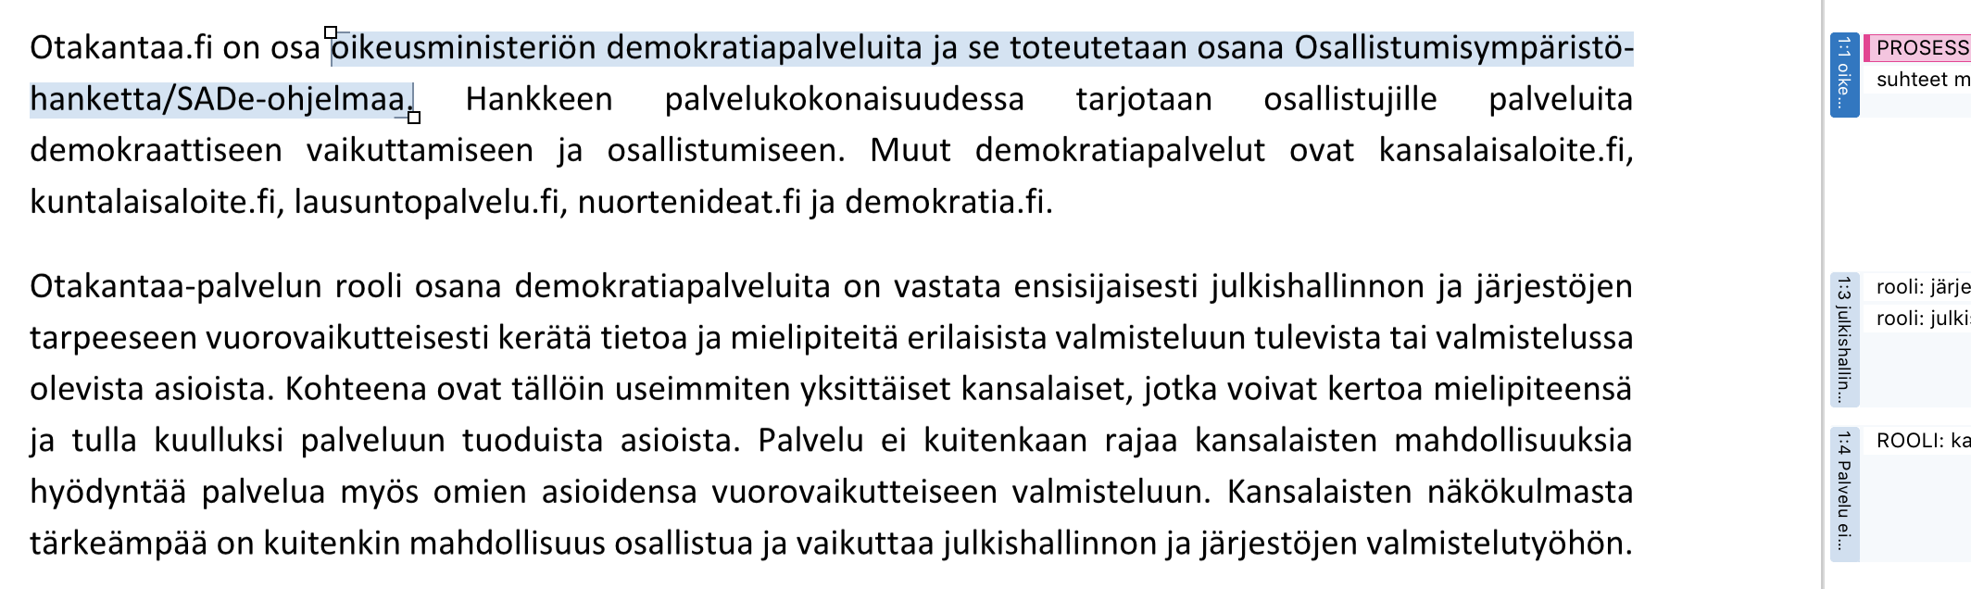
Coding in qualitative research

Slide 6
Grounded Theory (inspired approaches)
Open coding
Axial coding
Theory development
Detailed coding

Slide 7
Grounded Theory (inspired approaches)
Open coding
Axial coding
Theory development
Detailed coding

Slide 8
Grounded Theory (inspired approaches)
Open coding
Axial coding
Theory development
Detailed coding
Emergence

Slide 9
Conversation analysis

Slide 10
Qualitative data analysis
with automation

Slide 11
Computational data analysis approaches
Clean data
Preprocess data
Run your analysis

Slide 12
Computational text data analysis approaches
Clean data
Preprocess data
Run your analysis
Remove junk from the text data

Slide 13
Computational text data analysis approaches
Clean data
Preprocess data
Run your analysis
Remove junk from the text data
Text to corpus, some more data cleaning…

Slide 14
Computational text data analysis approaches
Clean data
Preprocess data
Run your analysis
Remove junk from the text data
Text to corpus, some more data cleaning…
Choose your analysis approach

Slide 15
Run your analysis
Computational text analysis is often counting words, in more or less fancy way.
Count frequency of particular keywords (dictionary based approaches)
Show the computer a lot of examples and reuse them (supervised methods)
Ask the computer to figure out what’s happening in the data (unsupervised methods)
Choose your analysis approach

Slide 16
Run your analysis
Computational text analysis is often counting words, in more or less fancy way.
Choose your analysis approach
Document | hello | world | dominance | …
1 | 1 | 1
2 |  | 1 | 1
…

Slide 17
Run your analysis
Computational text analysis is often counting words, in more or less fancy way.
Count frequency of particular keywords (dictionary based approaches)
Show the computer a lot of examples and reuse them (supervised methods)
Ask the computer to figure out what’s happening in the data (unsupervised methods)
Choose your analysis approach

Slide 18
Run your analysis
Computational text analysis is often counting words, in more or less fancy way.
Count frequency of particular keywords (dictionary based approaches)
Show the computer a lot of examples and reuse them (supervised methods)
Ask the computer to figure out what’s happening in the data (unsupervised methods)
Choose your analysis approach

Slide 19
Run your analysis
Analysis
Choose your analysis approach
“Theory”

Slide 20
Run your analysis
Analysis
Fear?
Choose your analysis approach
“Theory”

Slide 21
Run your analysis
Analysis
Fear?
Following words are often together in Finnish media dataset: ”gender”, “school”, “boy”, “girl”, “pink” – what does it mean?
Choose your analysis approach
“Theory”

Slide 22
Preprocess data
From text mass to a corpus and/or document-term matrix
Remove stopwords
Remove punctuation etc.
Text to corpus, some more data cleaning…

Slide 23
Clean data
Remove extra spaces
Remove markup
Remove junk from the text data

Slide 24
Danger zone

Slide 25
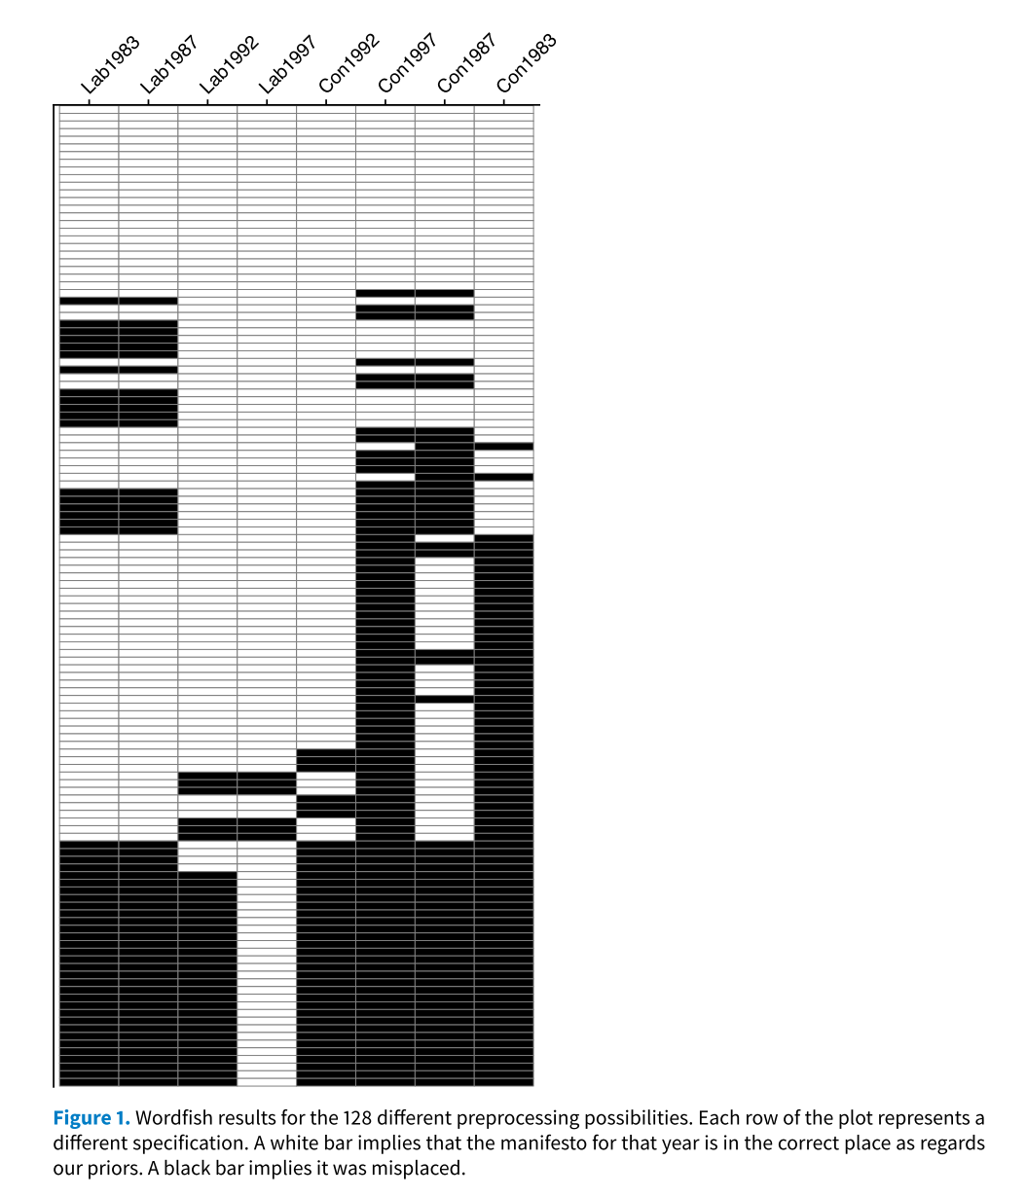
Denny, M. J., & Spirling, A. (2018). Text Preprocessing For Unsupervised Learning: Why It Matters, When It Misleads, And What To Do About It. Political Analysis, 26(02), 168–189. https://doi.org/10.1017/pan.2017.44

Slide 27
Nelimarkka, M. (2019). Aihemallinnus sekä muut ohjaamattomat koneoppimismenetelmät yhteiskuntatieteellisessä tutkimuksessa: muutama kriittinen havainto. Politiikka, 61(1), 6–33. Retrieved from https://journal.fi/politiikka/article/view/79629

Slide 29
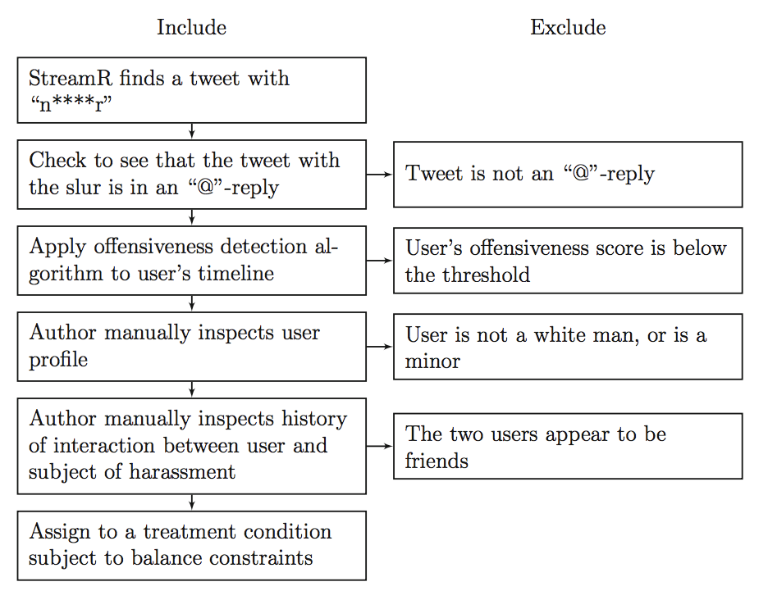
﻿I searched for tweets containing a powerful racial slur (‘‘n****r’’) to identify harassers with public Twitter accounts, and I assigned each subject to the control or to one of four treatment conditions.
Munger, K. (2017). Tweetment Effects on the Tweeted: Experimentally Reducing Racist Harassment. Political Behavior, 39(3), 629–649. https://doi.org/10.1007/s11109-016-9373-5

Slide 30
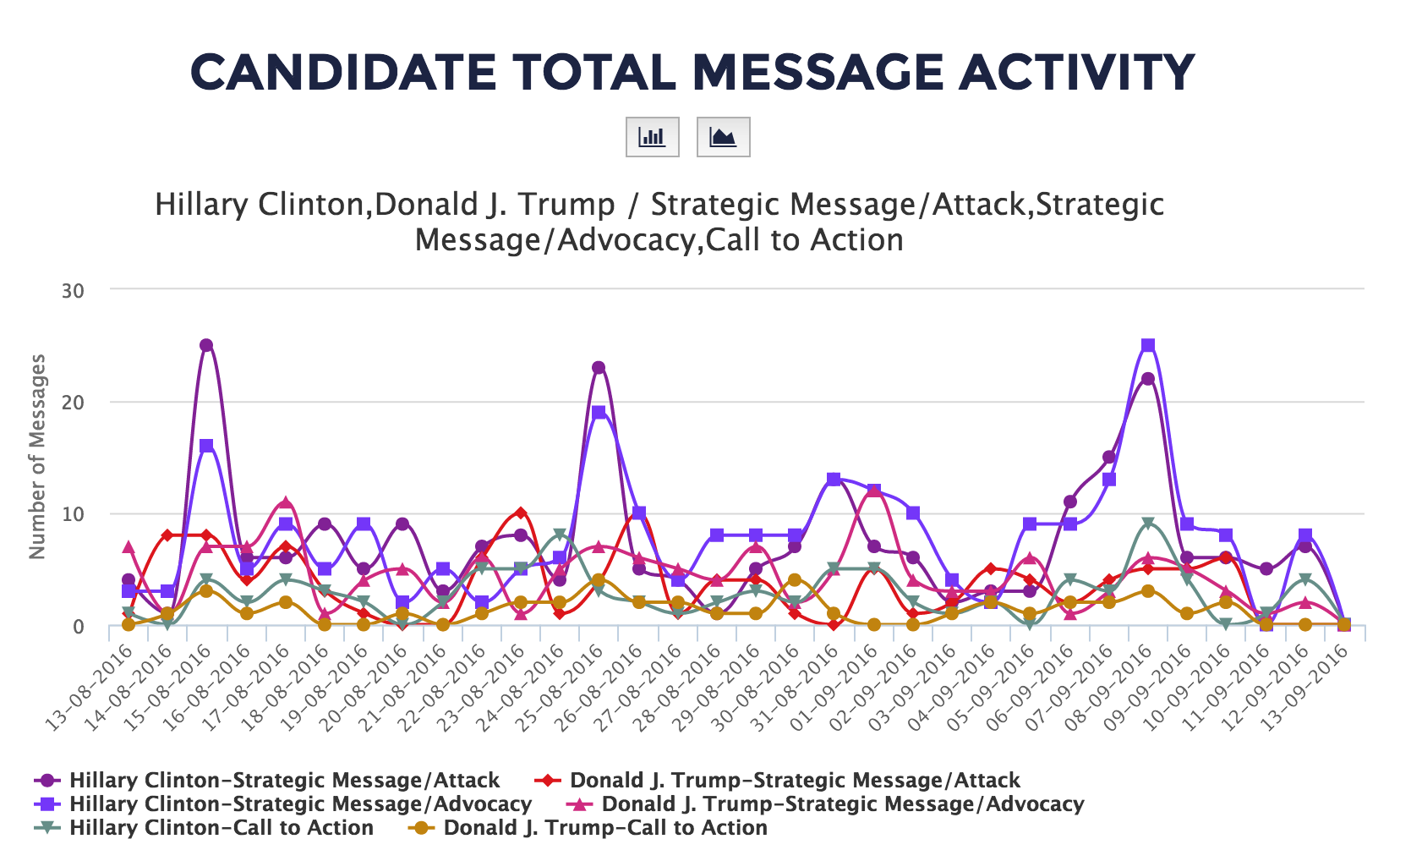
Example 1: Illuminating 2016 (School of Information, University of Syracuse)

Slide 31
CALL-TO-ACTION
Any message that is about supporters, focused specifically on encouraging them to do something (persuasion), is a call-to-action.There should be some force placed on the reader of the message to do something, even if it is softly expressed (e.g. “please come;” “we hope to see you there,”). Includes questions “have you seen our new ad?” Excludes rhetorical questions
Subcategories include:
Traditional Engagement: Messages that invite supporters or their friends or family to volunteer for the campaign in traditional ways: making phone calls, door-knocking, registering people to vote, holding a house party, attending an event, helping get people to the polls, join a debate watch party.
Digital Engagement: Messages that invite supporters or their friends or family to volunteer for the campaign in digital ways: watch or create videos or to share photos to submit online; or that encourage supporters to retweet or share a message, including encouraging the promotion of particular hashtags, memes, or images.
Media and Debate Appearances: Messages that encourage supporters to listen to the candidate or watch the candidate on the news, call-in shows, debates, forums.
Giving Money: Messages that invite supporters or their friends or family to give money to the campaign.
Buying Merchandise: Messages that urge people to buy items from the campaign, like hats, stickers, or buttons.
Vote: Messages that urge supporters to vote, or to vote for the candidate, including messages that have some policy or rationale component to them. Includes calls to register to vote, to vote early, or to mail in one’s absentee ballot, or urging people to “stand with” the politician on election day.
CEREMONIAL
Any message that is explicitly religious, gives thanks, praise, pays tributes, honors, or expresses condolences (using the terms that are associated with those) to family members, or the public around national holidays or commemorative events. Includes messages about winning or losing the election, including hope, anticipation, or disappointment around the election outcome. Includes messages that are simply jokes/puns/humor without reference to any of the other categories. Includes praise/cheers for sports teams/sports games (but not statements about the candidates at or watching events that have no praise).
CONVERSATIONAL TWITTER ONLY
Messages that are simply a direct address to a single person or a small group (2-3) of people in the form of a response to a message they received. These messages should feel like conversational replies to prior messages, even if it’s only “thanks”, and must contain a direct reference to the person/people they’re responding to.
INFORMATIVE
A message that that is to or about supporters (and observes of the campaign, such as the news media) focused specifically on information about the campaign (presented neutrally, without a persuasive appeal or action verbs is an information message).
ADVOCACY
A message that advocates for the candidate, highlighting their strengths as a leader, describing their prior policies or personal history, describing or featuring their family, describing or highlighting their current and future policy positions, or featuring their positive personality characteristics, is an advocacy message. Includes generic claims about the candidate being a good candidate, being supported, or being good for the state without explicit references to policy. Includes messages that position the candidate in opposition to policies or other candidates.
Image: a positive message about the candidate’s character, personality, style, values, or ability to lead.
Issue: a positive message about the candidate’s policy positions.
ATTACK
A message that criticizes the opponent or opposing administration or party on their personality, leadership skills, past behaviors, family, policy issues, campaign events, or any other negative focus on the opponent (or their campaign, surrogates, or family) is an attack message. Must be an explicit or strongly implicit reference to opponent, their party, or surrogates. Includes generic references to responses to attacks or attacking the opponent. Typically explicit references to the opponent are attacks, even if the attack is somewhat implicit.
Image: a negative message about the opponent’s character, personality, values, style, or ability to lead.
Issue: a negative message about the opponent’s policy positions.
ENDORSEMENT
Messages that feature an endorsement or support for the candidate from an important political person, celebrity, or organization: law enforcement, unions, the local newspaper, a prominent political figure.

Slide 32
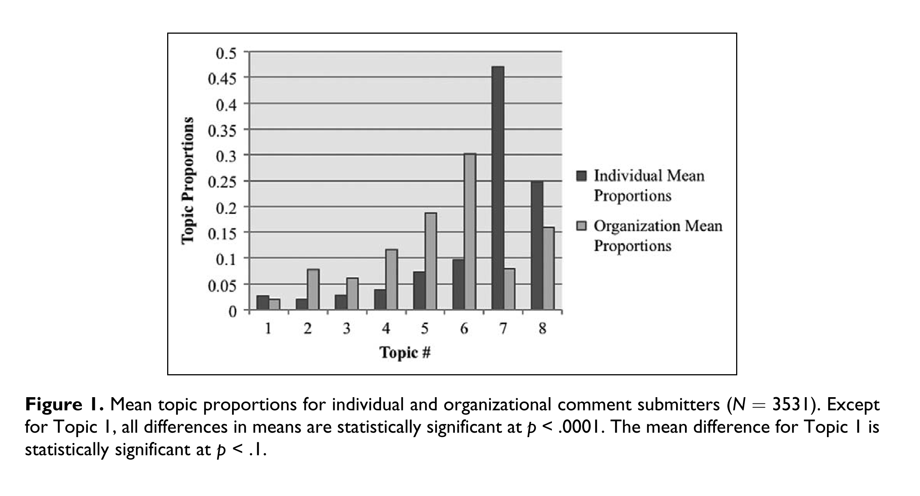
Levy, K. E. C., & Franklin, M. (2013). Driving Regulation: Using Topic Models to Examine Political Contention in the U.S. Trucking Industry. Social Science Computer Review, 32, 182–194. https://doi.org/10.1177/0894439313506847

